Slide 1




Project Tracking Tools
Task Management, Issue Trackers
Project
Tracker
SoftUni Team
Technical Trainers
Software University
http://softuni.bg

Slide 2


Table of Contents
Kanban Principles
Visualize and Manage the Workflow
Task Management Tools
Trello, GitHub Projects, Asana
Issue Tracking Tools
GitHub Issues, Trac, Bugzilla, JIRA

Slide 3
Have a Question?
sli.do #softuni-teamwork

Slide 4
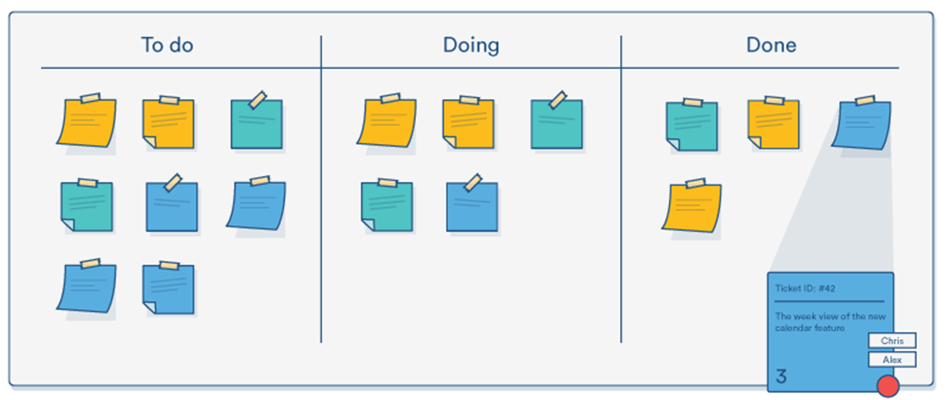
Kanban Principles
Visualize and Manage the Project Workflow

Slide 5
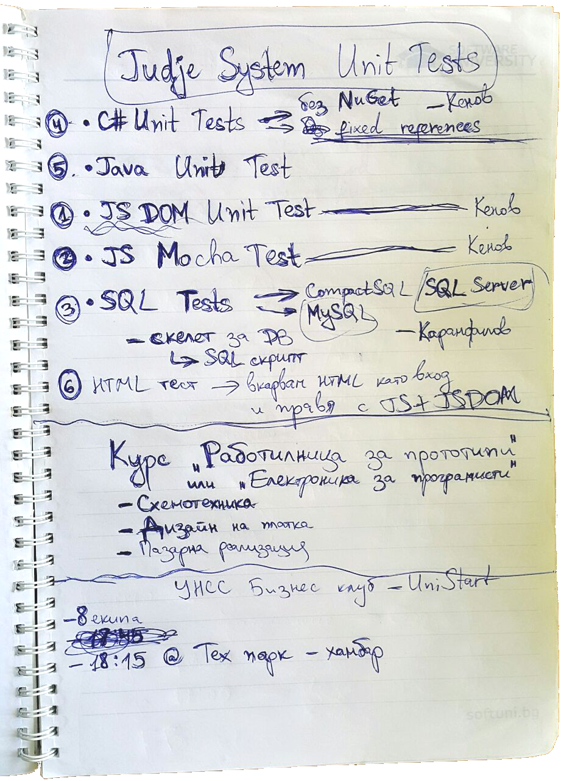
Working without a Project Tracker
Planning on handwritten task list
Works on small projects only
On very small teams / single person
Tends to be chaotic for larger projects
For better organization your project needs some kind of task tracker
Visualize, organize and manage the project plan / tasks / people

Slide 6
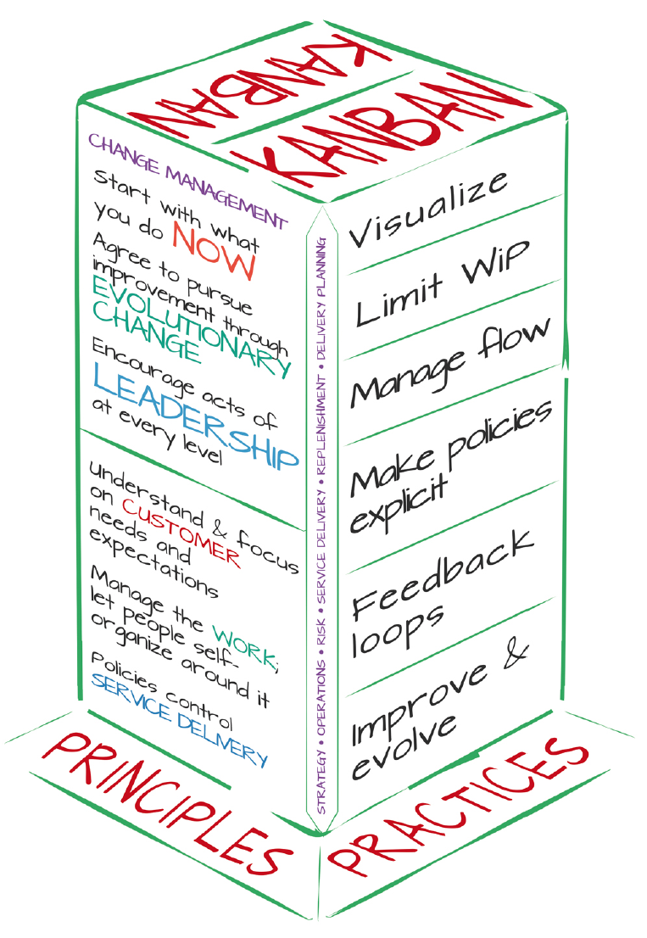
Kanban Principles
Start with what you do now
Respect the current process, roles, responsibilities, job titles
Visualize the workflow: use Kanban board
Manage workflow: fast smooth flow
Limit the work-in-progress (WIP) items
Incremental, evolutionary change

Slide 7
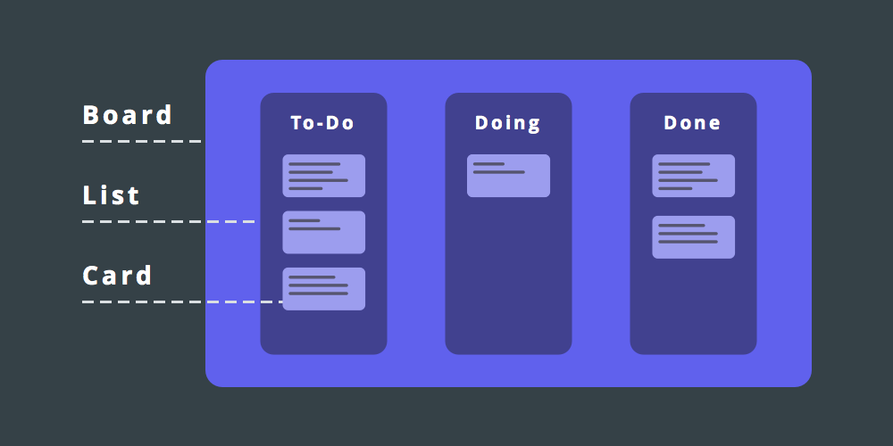
Kanban Board

Slide 8
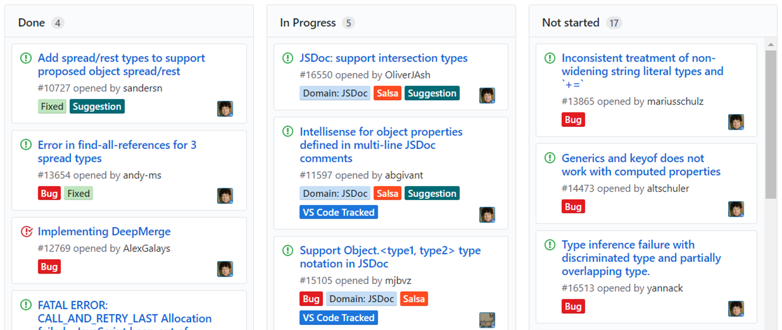
Task Tracking Tools
Kanban Boards / Task Management Tools

Slide 9
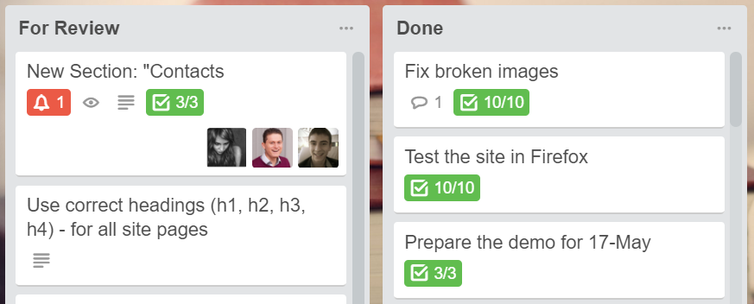
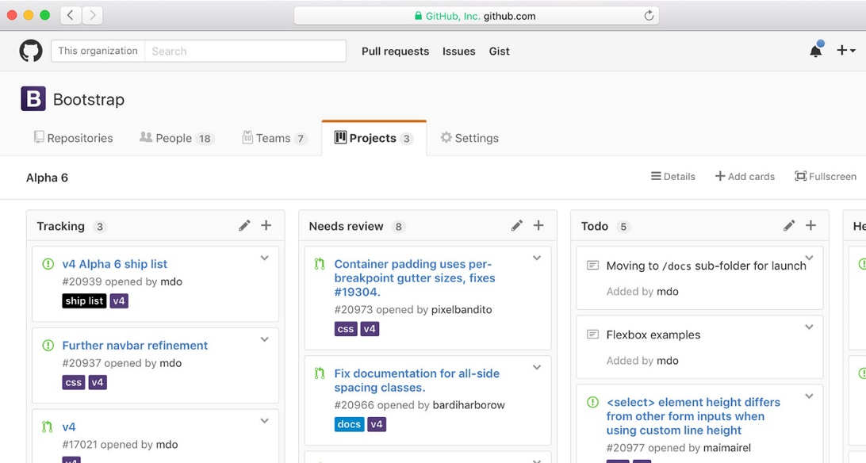
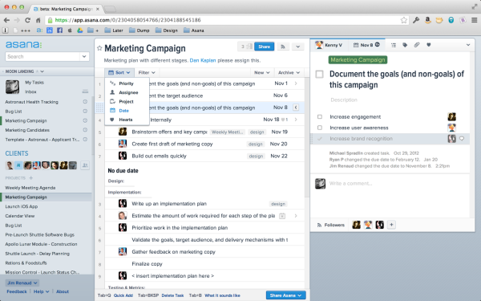
Task Management Tools
Trello – a free Kanban board task tracker
https://trello.com
GitHub Projects – a free Kanban board in GitHub
https://github.com/{...}/projects/
Asana – online project management / tracker tool
https://asana.com

Slide 10
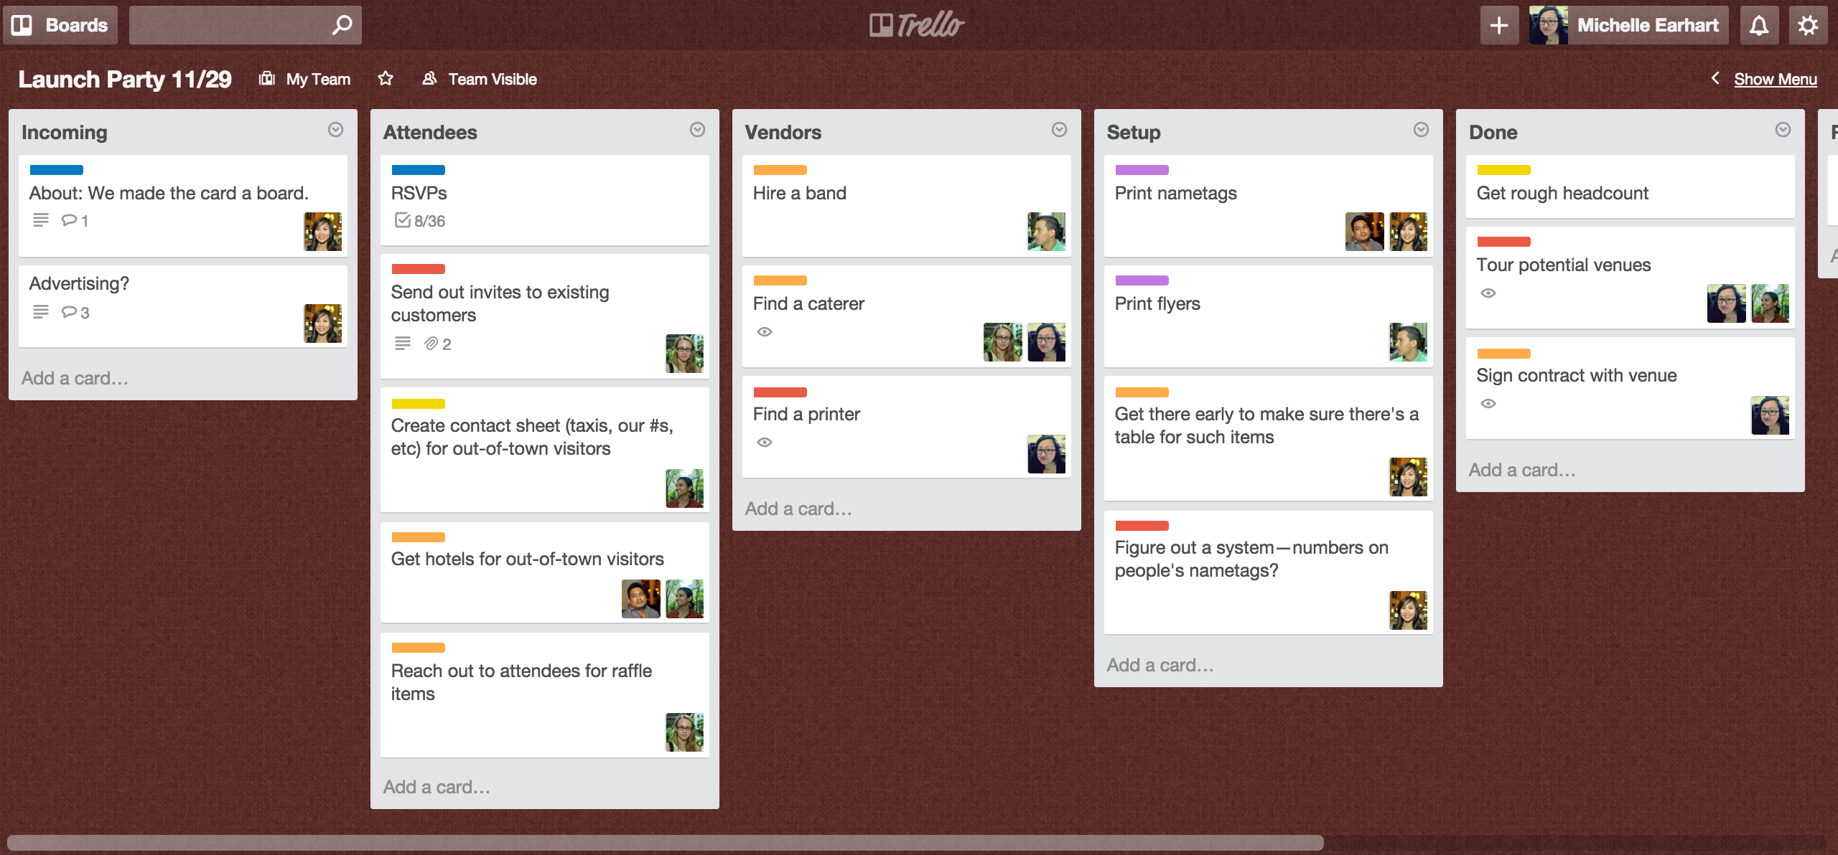
Trello – A Simple Kanban Board
https://blog.trello.com/trello-board-best-practices

Slide 11
Using Trello for Task Tracking
Live Demo

Slide 12
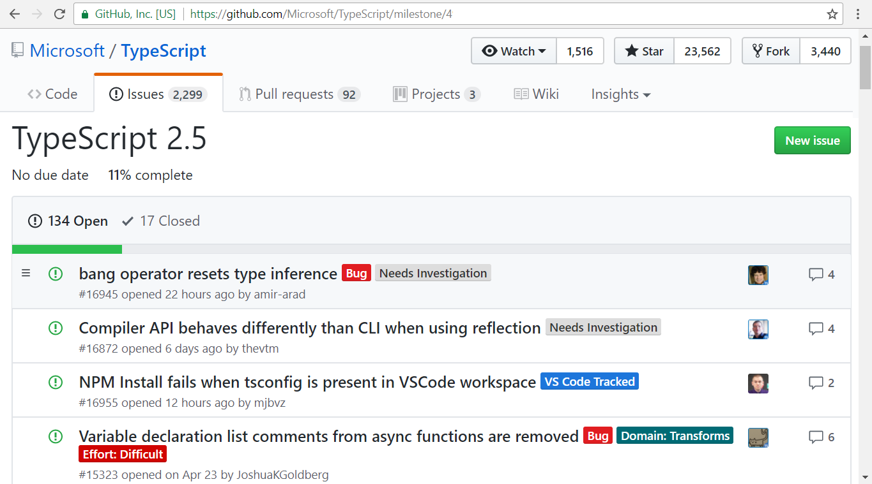
Issue Tracking Tools
Tracking / Managing Bugs / Issues

Slide 13
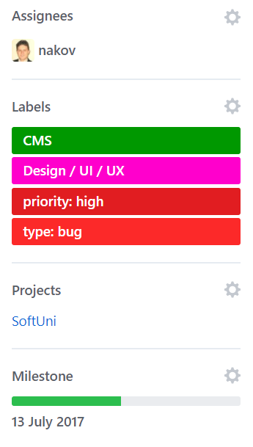
Issue Trackers and Issues
Issue trackers track bugs / problems / issues
Create / edit / close issues
Issues (tickets) typically have
Title, description, comments
Labels / categories / tags
Severity / urgency / priority
Assigned person
Milestone / deadline

Slide 14
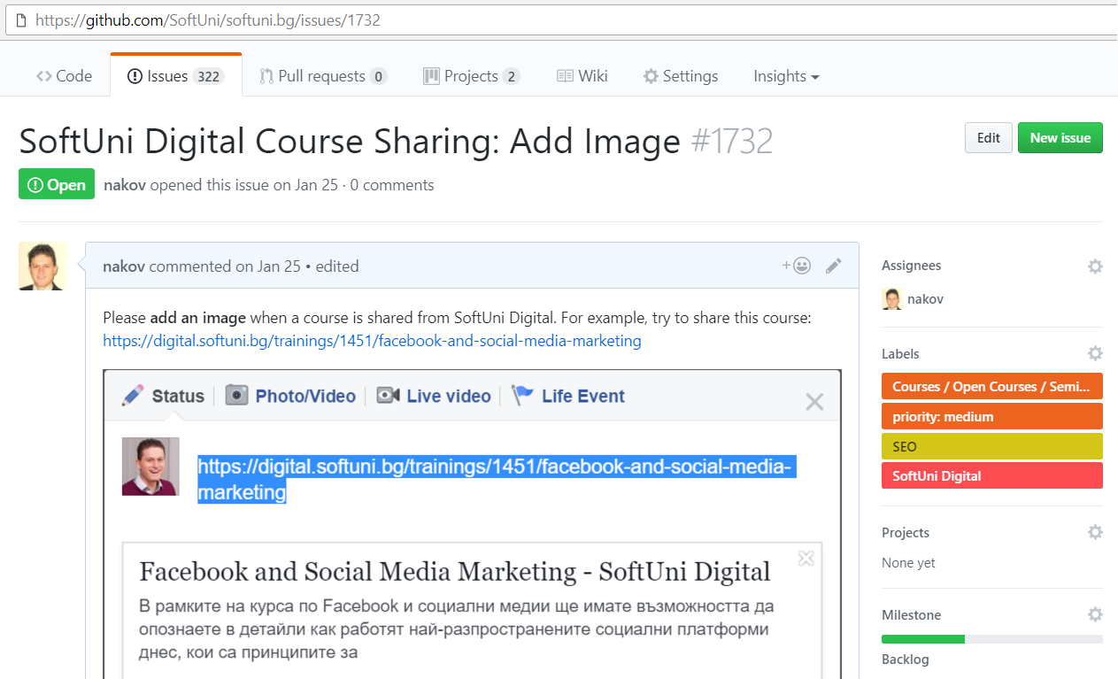
Sample GitHub Issue

Slide 15
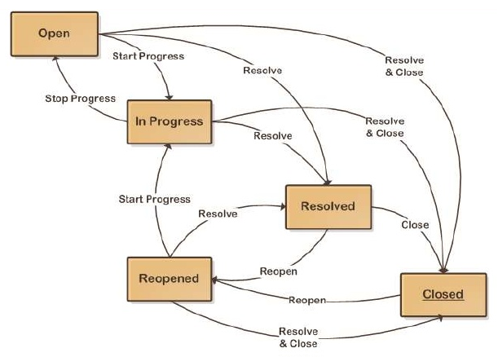
Issues Workflow – Example

Slide 16
Using the GitHub Issue Tracker
Live Demo

Slide 17

Creating a Web Site using Trello
Create a very simple Web site for imaginary software company
Pages: Home, About, Services, Portfolio, Careers, Contacts
Split the work into tasks in Trello
Backlog | In Progress | Done
Keep the project in GitHub
Live Exercises in Class (Lab)

Slide 18
UI Prototype for the Web Site
Software Company – Home
Top Menu: [Home] [About] [Services] [Portfolio] [Careers] [Contacts]
Page Content Comes Here
Footer

Slide 19
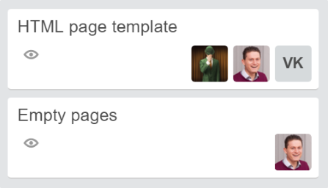
Tasks to Put in Your Kanban Board
Create a HTML page template
Create the CSS styles
Create empty pages: Home, About, …
Fill the content for the Home page, About page, …
Add texts, add images, add videos, other content …
Review the content for the Home page, About page, …
Publish the site in GitHub pages

Slide 20
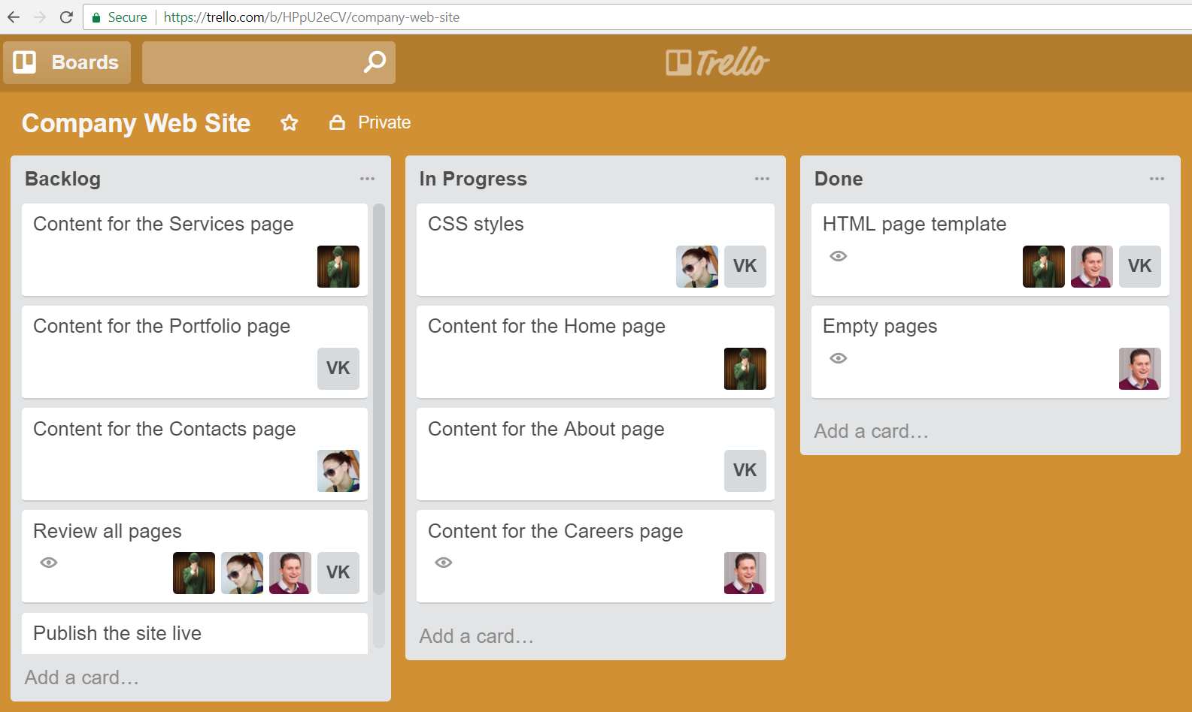
Company Web Site – Sample Trello Board

Slide 21
Using the GitHub Issue Tracker
Log several issues in GitHub
Labels: [UI / UX], [Content], [Type: bug], [Type: feature], [Priority: high], [Priority: low], [Priority: medium]
Perform the work in some issue and close it with comment
Live Exercises in Class (Lab)

Slide 22
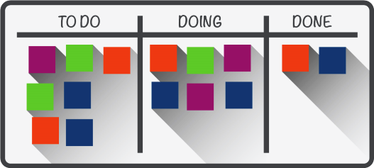
Summary
Kanban workflow
Visualize the project on Kanban board
Tasks flow: [TODO] → [Doing] → [Done]
Use task management tools
Trello, GitHub Projects, Asana
Use issue trackers for bugs / tickets
GitHub Issues, Trac, Bugzilla, JIRA

Slide 23







Project Tracking Tools
https://softuni.bg/courses/practical-teamwork

Slide 24





Trainings @ Software University (SoftUni)
Software University – High-Quality Education, Profession and Job for Software Developers
softuni.bg
Software University Foundation
http://softuni.foundation/
Software University @ Facebook
facebook.com/SoftwareUniversity
Software University Forums
forum.softuni.bg

